Slide 1
Post-Market surveillance of Illumina products
Ivan Charkin, Jeff Leath, Alec Neff
MSDS 7330 project
April 16, 2019

Slide 2
Summary
I
For this project we collected the post-market data on the performance of products made by Illumina
The data were obtained by collecting tweets related to the company products from Twitter using a custom Python script
The tweets were organized in a MongoDB database for further analysis and custom summaries
Simple Natural Language Processing analysis of the tweets collected in the database was demonstrated

Slide 3
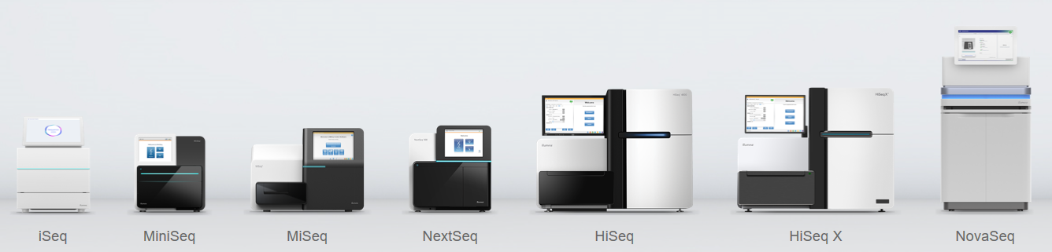
Illumina
I
Illumina is a leading company in the DNA sequencing market
It produces multiple platforms of DNA sequencers for various applications and consumables used for sequencing runs
The products are used for both research and medical diagnostics purposes (e.g. in-vitro diagnostics, cancer research)
www.illumina.com

Slide 4

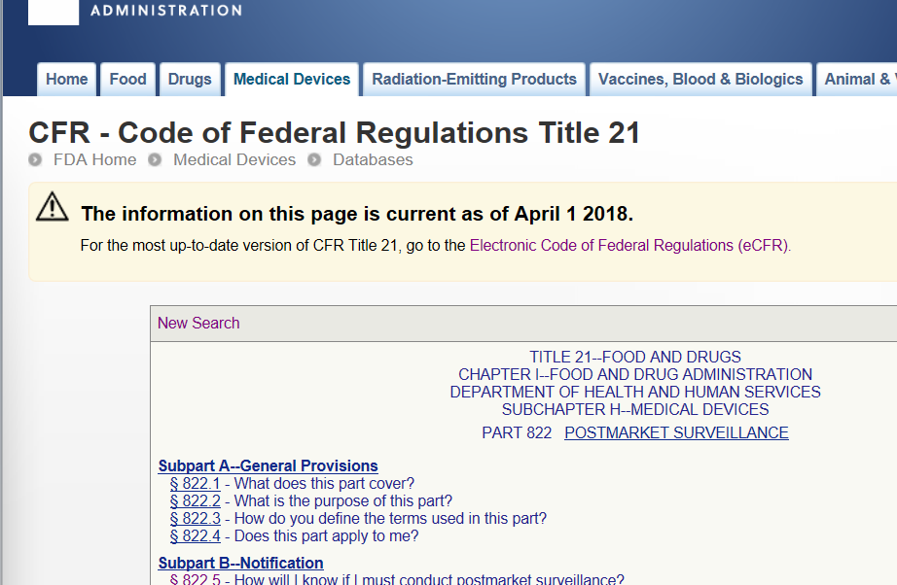
Post-market surveillance
I
For on-market products it is generally a good practice to proactively seek customer feedback on the product performance instead of relying on complaints only
For medical devices proactive collection of data is required per Federal Regulations as part of post-market surveillance to identify any problems with the product
The data are supposed to be collected during the whole time the product is on the market

Slide 5
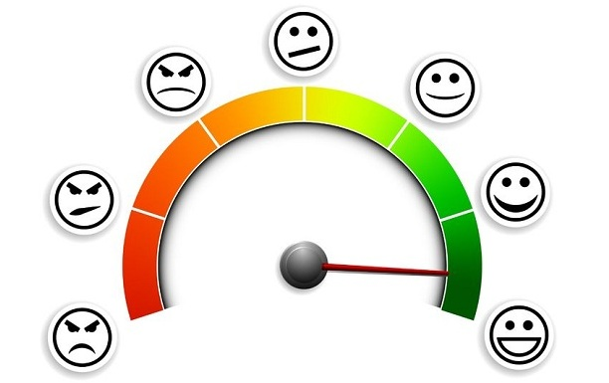
Examples of post-market data sources
I
Customer complaints
Customer polls and questionnaires
Parts replacement data
Returns data
Clinical studies
Social media discussions – focus of this project

Slide 6



Data collection from social media
J
There are several specialized websites hosting discussion forums for specific applications of Illumina products, but the data access is limited
For this project we chose Twitter
The length of each message is limited (280 characters)
There are already libraries available to make data gathering simpler

Slide 7
Twitter data collection
J
I
Python library “Tweepy” was used to create a script that interacts with the Twitter application programming interface (API)
Free account with Twitter allows to search and download tweets posted in the previous 7 days
We performed a query for specific keywords which mentioned Illumina products
The following keywords were used:
Illumina
MiSeq
MiniSeq
NextSeq
NovaSeq
iSeq
HiSeq
The search was case insensitive:
“ILLUMINA”, “Illumina”, “illumina”
tweet_mode="extended“ was used to obtain full text of tweets

Slide 8
“Tweepy” return
I
['__class__', '__delattr__', '__dict__', '__dir__', '__doc__', '__eq__', '__format__', '__ge__', '__getattribute__', '__getstate__', '__gt__', '__hash__', '__init__', '__init_subclass__', '__le__', '__lt__', '__module__', '__ne__', '__new__', '__reduce__', '__reduce_ex__', '__repr__', '__setattr__', '__sizeof__', '__str__', '__subclasshook__', '__weakref__', '_api', '_json', 'author', 'contributors', 'coordinates', 'created_at', 'destroy', 'entities', 'favorite', 'favorite_count', 'favorited', 'geo', 'id', 'id_str', 'in_reply_to_screen_name', 'in_reply_to_status_id', 'in_reply_to_status_id_str', 'in_reply_to_user_id', 'in_reply_to_user_id_str', 'is_quote_status', 'lang', 'parse', 'parse_list', 'place', 'possibly_sensitive', 'retweet', 'retweet_count', 'retweeted', 'retweets', 'source', 'source_url', ‘full_text', 'truncated', 'user']
_json - JSON serializable response data as a dictionary
json.dumps extracts the data in JSON format
Only unique non-retweeted entries were collected

Slide 9
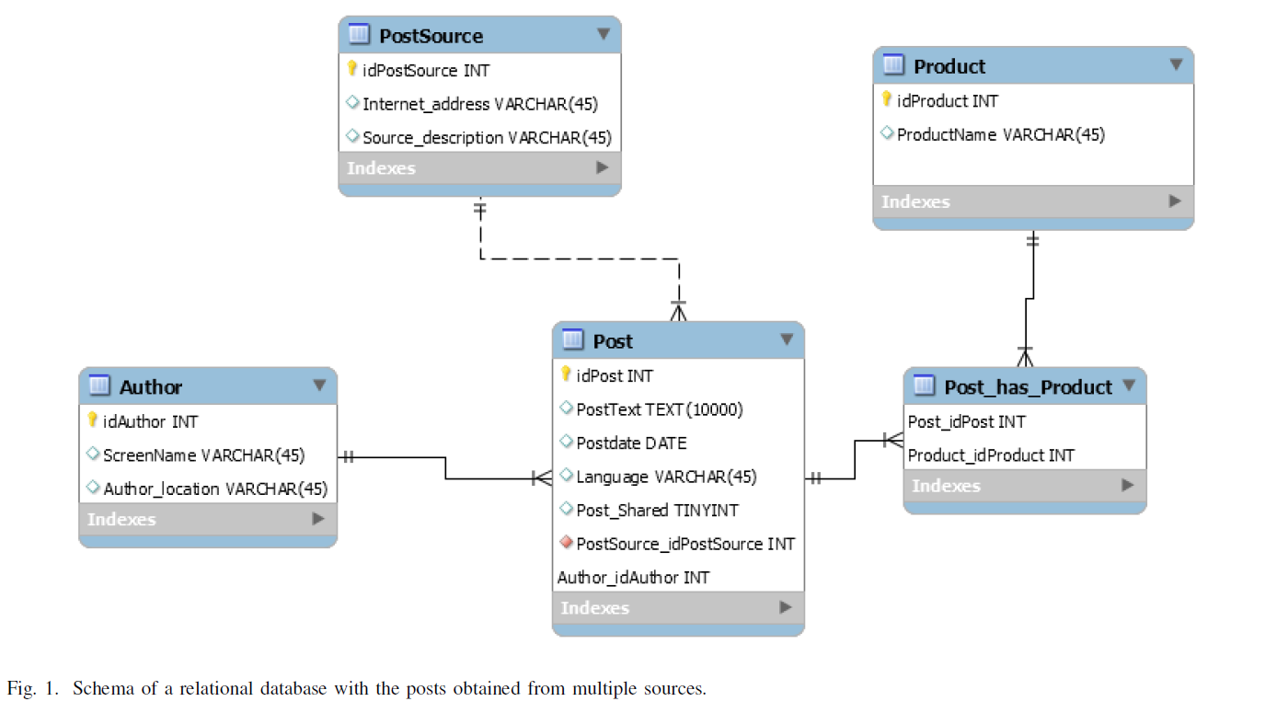
Database plan
A
Initial Plan – Relational database in MySQL
This schema would cover needs of collecting data from multiple sources

Slide 10
Database plan
A
Based on new learnings, time available for the project and availability of JSON output - MongoDB

Slide 11


Database plan
A
I
Final Plan - MongoDB
mongoimport tool imports content from an Extended JSON, CSV, or TSV export created
Since only 1 week of data was available at a time, the database was updated with new data as it became available
“upsert” function to append new records

Slide 12
Natural language processing
J
Queried MongoDB with Python
Established connection with MongoDB using “pymongo” library and query the data
Used “textblob” library for rudimentary Natural Language Processing
TextBlob allows to detect language and translate into English
Although not perfect – allows to analyze tweets in other languages
TextBlob was used to run a sentiment polarity analysis

Slide 13
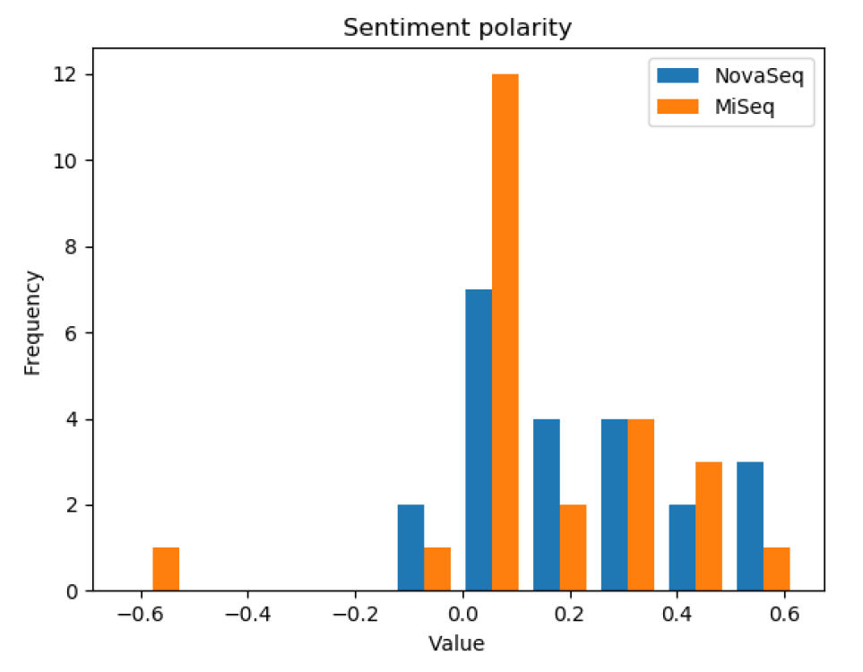


Natural language processing Sentiment Polarity Analysis
J

Slide 14
Natural Language Processing Sentiment Analysis “Pitfalls”!
J
”Just shy of 4 TeraBases for our S4 NovaSeq run. That is seriously mad!”
-Score very low
-Reality very positive

Slide 15
Conclusions
I
Unstructured data scrapped from internet
Created scalable database
Utilized DB for value added activity

Slide 16
Questions?

